Slide 1
Mars 2040 Optimization
16.888 Final Presentation
Parker Vascik
Eric Ward
Sam Wald
5/10/2016

Slide 2



Motivation: Martian Settlement
US Space Policy and NASA’s Current Goals
Sustainable, indefinite human presence in deep space
Objectives of human space endeavors:
Scientific
Aspirational/Political
Safe-haven for humanity
Constraints:
Budgetary
Technological
Mars 2040 Settlement
Resupply Optimization
NASA, “Journey to Mars.” 2015.

Slide 3
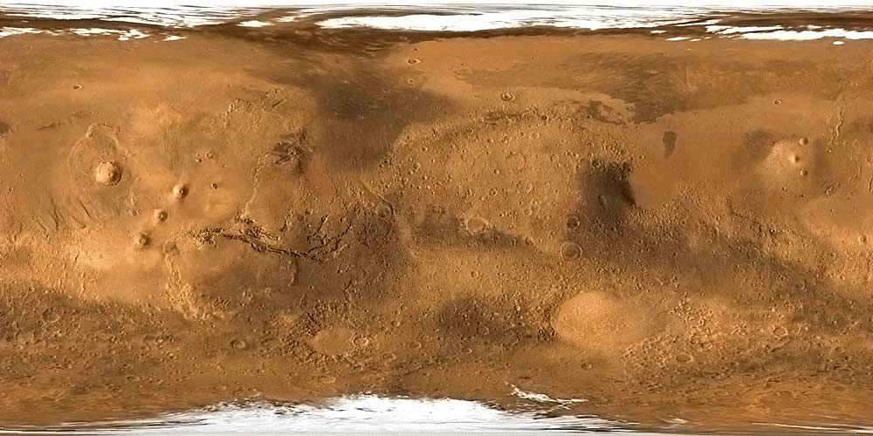
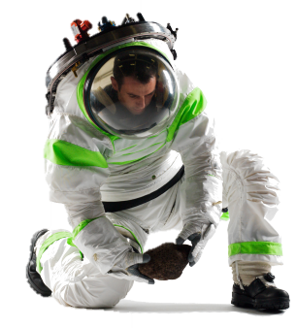
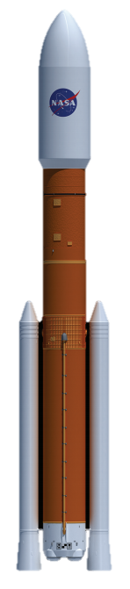
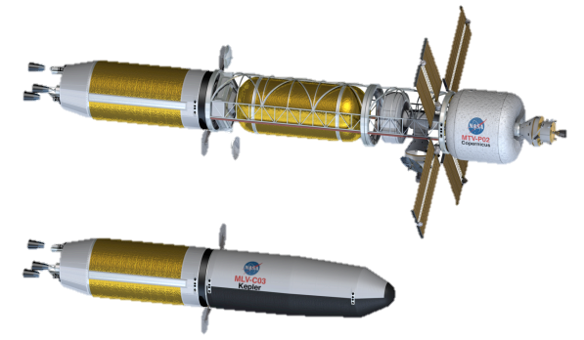

Problem Formulation: Objectives
Objectives
Science Utility
Number of Crew Hours
Location Scientific Quality
Cost
Resupply Cost
Total IMLEO
Development Cost
Transit Propulsion Capabilities
NASA, “Journey to Mars.” 2015.
Borowski, “7-Launch NTR Space Transportation System.” 2009.
Notes:
Open Source: opensource.org
Fidelity:

Slide 4
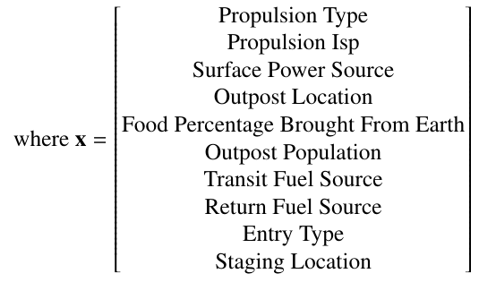





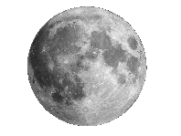
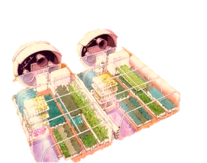
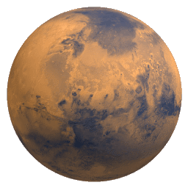

Problem Formulation: Variables
Design Variables
10 Total Design Variables
8 Discrete Variables
2 Continuous Variables
Propulsion Type and Isp directly effect Development Cost
Location, Population, and Food directly affect Science Utility
Toups, “Transportation-Driven Mars Surface Operations.” 2014
Notes:
Open Source: opensource.org
Fidelity:

Slide 5
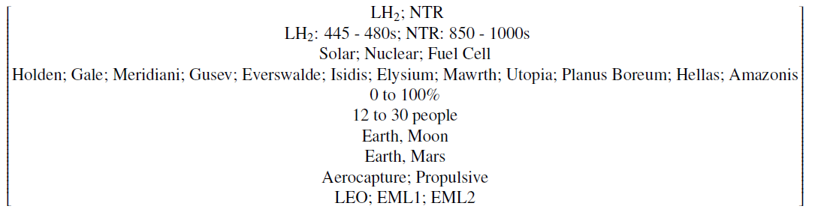
Problem Statement

Slide 6
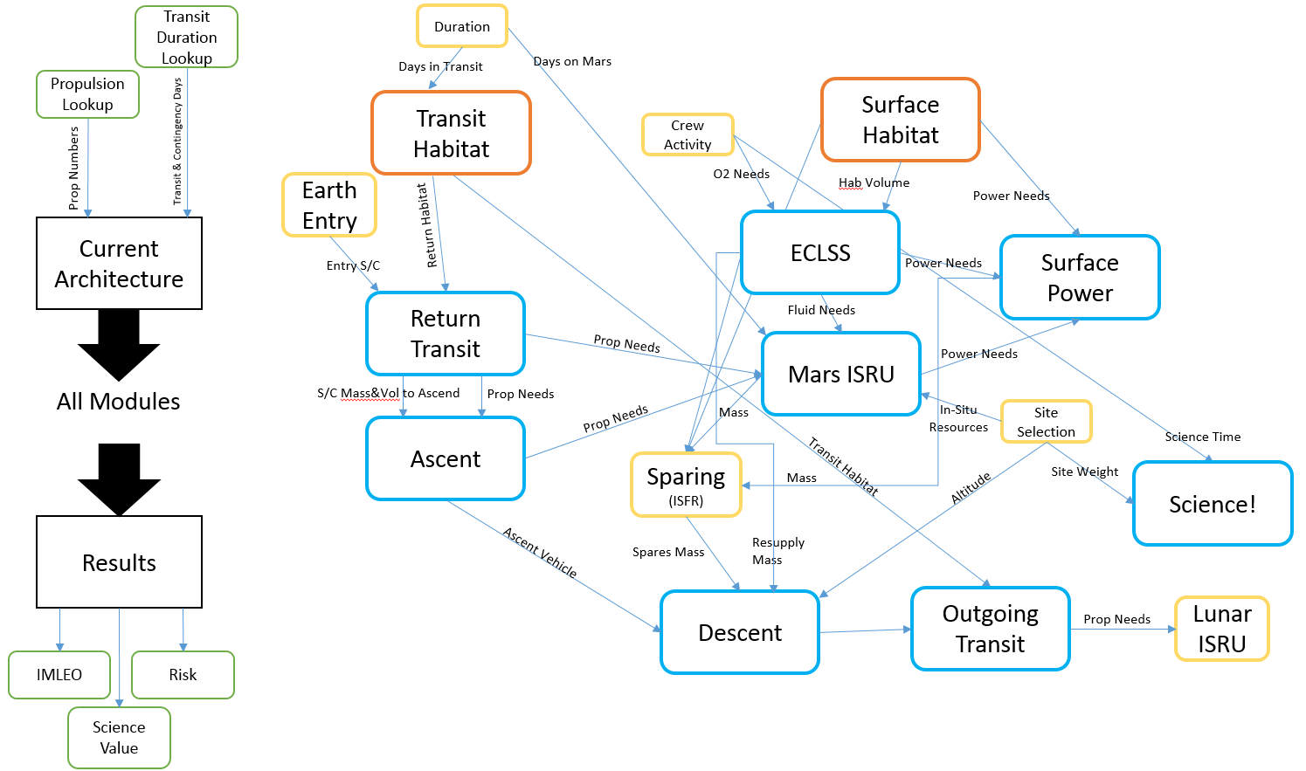
Modeling and Simulation: Modules

Slide 7
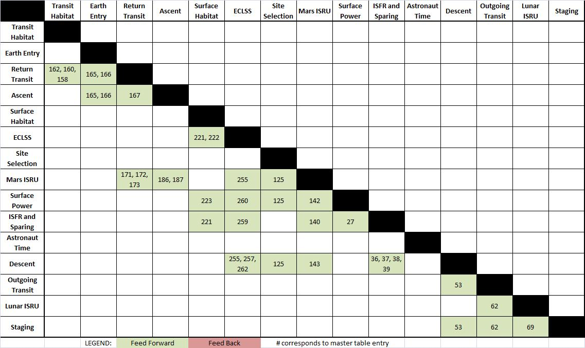
Modeling and Simulation: DSM
Reordered to minimize feedback relationships

Slide 8
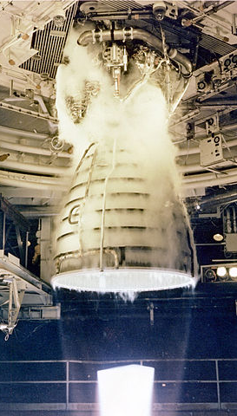
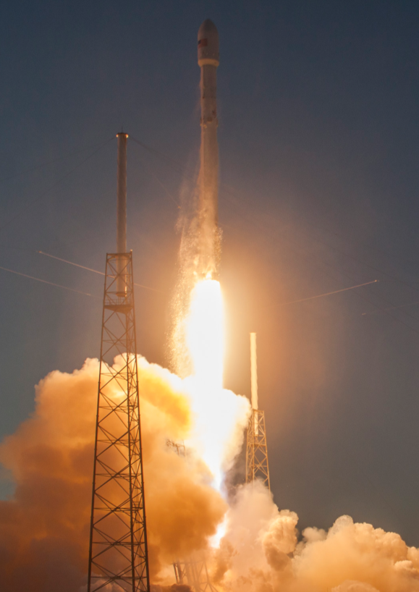
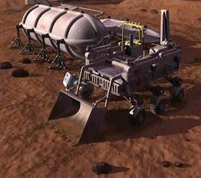
Modeling and Simulation: Multidisciplinary Expansions
Two additional modules were developed to capture relevant objectives for the Mars 2040 campaign model
Advanced Technologies Development Cost
IMLEO Operational Cost
http://www.exploremars.org/
www.spacex.com
Notes:
Review why these two objectives are especially important in the pre-conceptual design phase planning of a Mars campaign
Introduce the two technologies we are considering, advanced propulsion and ISRU. Cite Sydney’s thesis as a reason that we are focusing on ISRU instead of recycling techs

Slide 9
Modeling and Simulation: Multidisciplinary Expansions
IMLEO Costs
Technology Development
New Modules

Slide 10

Modeling and Simulation: Science Utility Module
Inputs
Output location’s scientific interest
Geological, Biological
Amount of time on surface available for science tasks
Entry time (aerocapture vs. propulsive landing)
Crop tending time (biomass production vs. Earth-based)
$$S=\left(B_{i}+G_{i}\right) P t$$
S = science utility (interest-crew-hours)
B_{i} = site biological science interest (interest)
G_{i} = site geological science interest (interest)
P = surface population (# people)
t = time available for science activities (hours per person)

Slide 11
Modeling and Simulation: Development Cost Module
Investment in advanced technologies may be traded with:
Reductions with campaign operational costs
Enhancement in mission value (or perhaps safety)
Advanced propulsion will:
Reduce fuel requirements for IMLEO or ISRU
Potentially reduce transit time increasing astronaut time on Mars
Chemical engine Isp improvements and nuclear thermal rockets are considered in this analysis
Notes:
Talk about how advanced ISRU was found to be a non-started in our analysis since the time savings of more efficiency ISRU are not accounted for in our model. But, we do find that full lunar and full mars ISRU make the most efficient missions, so we need to develop that baseline technology

Slide 12
Modeling and Simulation: Development Cost Module
Cost estimation for low Technology Readiness Level (TRL), far-term developments is a significant field of active research
The NASA Advanced Missions Cost Model (AMCM) was utilized in this research
The model is an analytic expression created from historical data of over 300 NASA advanced missions and technology development programs
Q = quantity of units produced
M = dry mass of technology in lbs
S = specification of technology
IOC = initial operating capability
B = block number of technology
D = difficulty to develop technology
Notes:
Talk about limitation of amoritization of development cost over multiple mission campaign

Slide 13
Modeling and Simulation: IMLEO Cost Module
A significant proportion of space mission costs results from initial launch cost into low earth orbit
New provider entrants into the market have provided opportunity (and uncertainty) for future IMLEO costs
The following three values were used as high, medium, and low IMLEO cost estimates in this analysis
Specific launch manifesting and impacts on operations not considered at this time.
Launch System | IMLEO Cost Estimate
Historical Baseline | $10,000/kg
Space Launch System | $7,000/kg
SpaceX Falcon Heavy | $1,600/kg

Slide 14
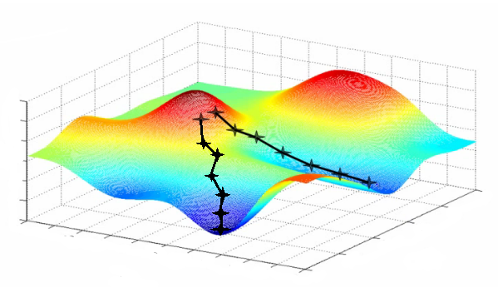
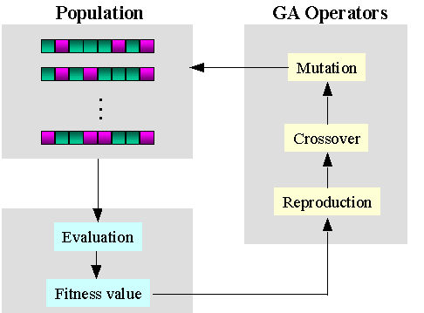
Single Objective Optimization
The first attempt of wrapping the Mars 2040 campaign model in an optimizer explored two different single objective algorithms
Coordinate Search
non gradient-based
multi-dimensional steepest descent
local minimum susceptible
Genetic Algorithm
full design space coverage
unlikely to converge on local minimum
computationally intensive
www.holehouse.org
www.ewh.ieee.org
Notes:
Explain that we didn’t want to go right to multi-objective optimization
The coordinate search is very good for local minimization as it is guaranteed to fined a local min, but with very complex design spaces it may not find the global min (requires multiple starting points)
GA is good for global search to identify the region of the global min. More computational expensive and not guaranteed to converge on global min

Slide 15
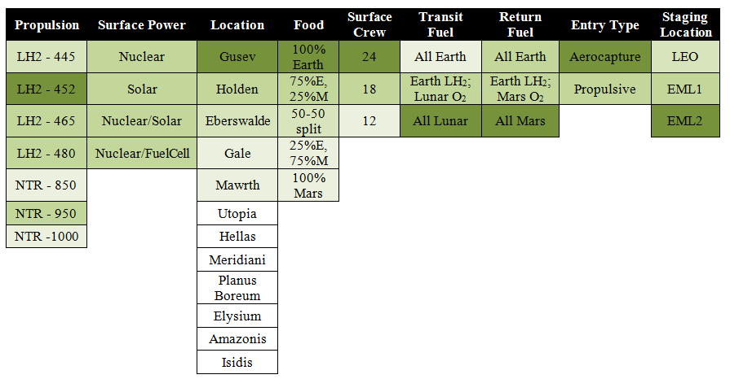
Single Objective Optimization Coordinate Search
The efficiency of the coordinate search was maximized by “smoothing” the design space, or removing local minima
The design space smoothing has limited accuracy around an initial design point

Slide 16
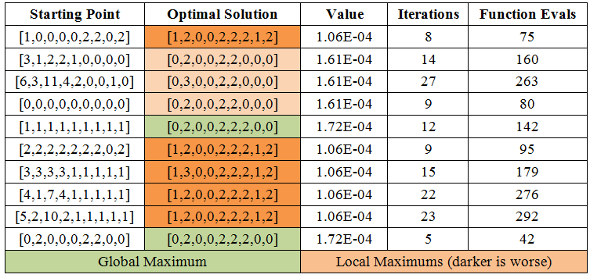
Single Objective Optimization Coordinate Search
The coordinate search was executed for ten initial starting points
Numerous local maxima exist despite smoothing efforts
1604 total function evaluations
Notes:
We will compare the optimal result of the coordinate search with that of the GA in a few slides

Slide 17
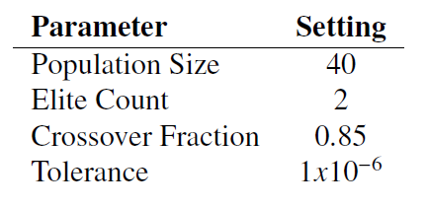
Single Objective Optimization Genetic Algorithm
The MATLAB genetic algorithm toolbox was utilized
Smoothing of the design space was not necessary
The parameters of the genetic algorithm were tuned to provide consistent convergence
The final optimizer converged in an average of 53 generations and 2081 function calls
Multiple trials were executed to ensure solution agreement

Slide 18
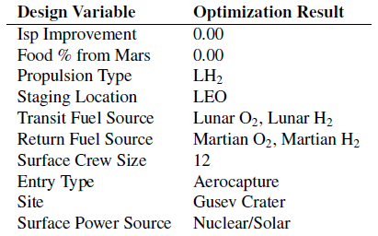
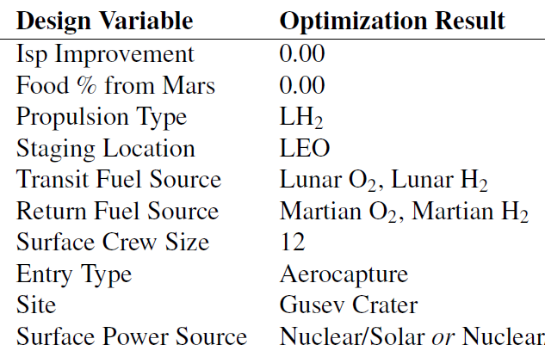
Single Objective Optimization
The single objective results of the coordinate search and genetic algorithm yield very similar solutions
Coordinate Search
1604 function evaluations*
Optima value: 1.72e-4
Genetic Algorithm
2081 function evaluations†
Optima value: 1.72e-4
*for 10 coordinate search runs
†for a single GA run
Notes:
Discuss how the two algorithms were validated against one another, as well as internally through multiple rounds of convergence testing (with different initial points and parameters and such)

Slide 19
Multi-Objective Optimization
Multi-Objective Genetic Algorithm:
Matlab gamultiobj
Custom integer mutation and crossover functions
Convergence
Large jumps between successive iterations due to integer variables.
Criteria: average change in average fitness < tol

Slide 20
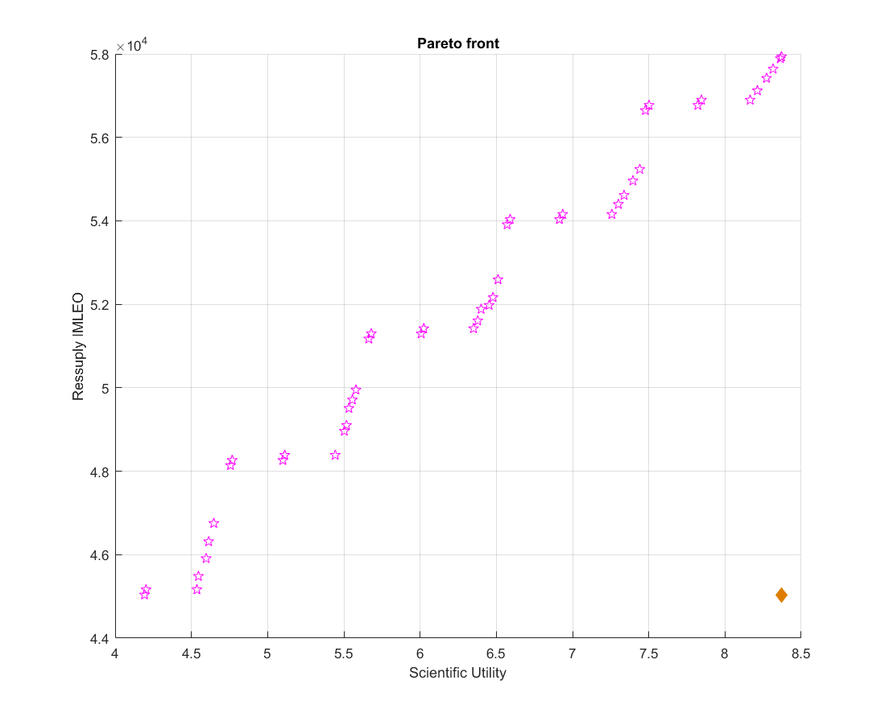


Multi-Objective Optimization
23-25 crew
20-22crew
19-21 crew
16-18 crew
14-15 crew

Slide 21
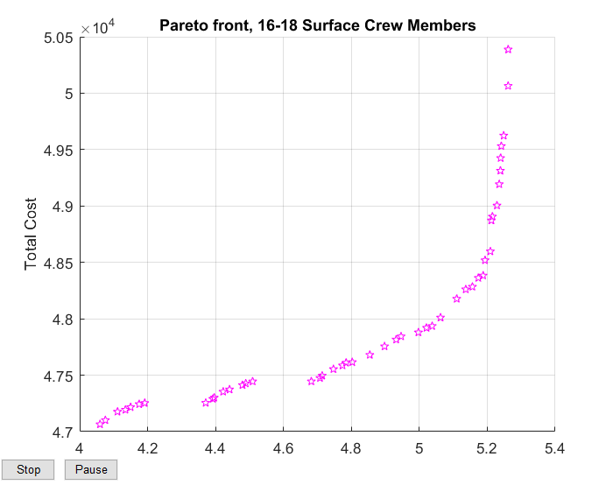
Multi-Objective Optimization

Slide 22
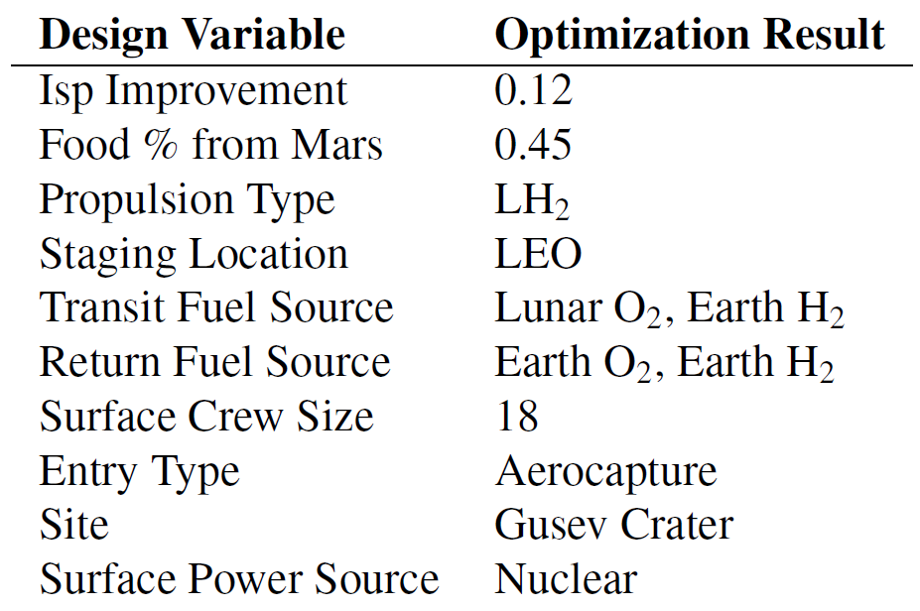
Final Recommendation

Slide 23
Learnings and Future Work
Additional Variables
Martian ISRU efficiency (ECLSS consumables, ascent prop)
Automated plant growth systems
Alternate sites
Additional development costs
Additional Objectives
Initial emplacement costs
Risks (Technological, Operational)
Additional Sensitivities
Development costs
Site science interest
Settlement time horizon

Slide 24
Acknowledgements
Dr. de Weck
Dr. Do
Dr. Basdogan
Dr. Mueller
Mr. Chang
16.888 Classmates

Slide 25
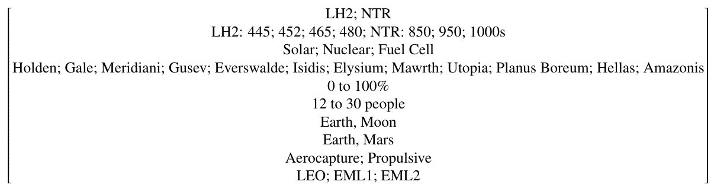
Problem Formulation: Bounds and Constraints
Variable Bounds
Current Mars information
Theoretical limits
Current capabilities
Expected developments
Constraints
Physics-based dependencies
Mass and energy balance
Drives system sizing
Habitation
Transportation
Power
ISRU
ISFR
Staging

